Slide 1
Gene Pools

Slide 2
What are we doing today?
Populations can be represented as gene pools that reflect the frequency of alleles of a particular gene; gene pools can be used to compare populations at different times or locations (SU)
Gene pools are dynamic, with changes in allele frequency caused by:
changes in gene flow between adjoining groups
differing selection pressures (natural selection)
random genetic drift, including the founder effect (SU)
The incidence of genetic diseases in particular populations illustrates the effects of different factors on the dynamics of gene pools, including the incidence of Tay-Sachs disease, thalassemia and sickle-cell anaemia (SU)

Slide 3
Gene Pool
Species: Group of individuals that share similar characteristics and are able to reproduce and produce fertile offspring.
Alleles: Alternative form of genes.
Population: group of organisms of same species living in a particular place at a particular time.
Gene pool: All the different alleles in a given population

Slide 4
Gene pools are dynamic
Can be affected or changed by:
Mutations: introduce new characteristics into a population
Changes in gene flow between adjoining groups: introduction of new alleles or increasing frequencies of alleles into population due to migration
Differing selection pressures (natural selection): if some alleles are more ‘favoured’ than others than the frequency of the characteristic in a population will change
Random genetic drift, including the founder effect: By chance the frequency of an allele may change in small populations, some alleles may be over-or under-represented.

Slide 5
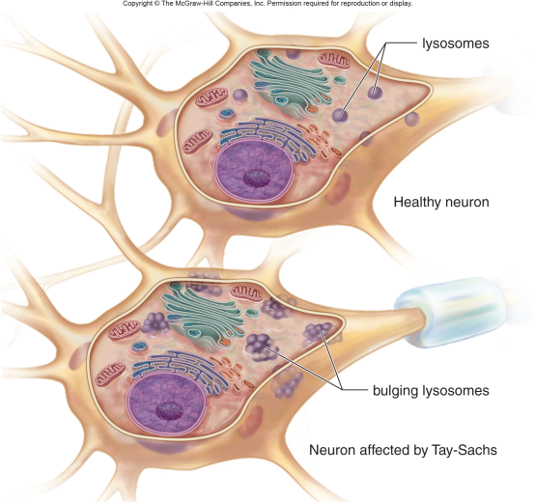
Tay-Sachs
Missing enzyme essential for fat metabolism
Build–up of fatty substances in the nervous system
From a few months of age mental and physical disabilities develop quickly (eg. blindness, deaf, unable to swallow, atrophied, paralytic)
Recessive trait/passed from two carrier parents
Affects Ashkenazi Jew/Jewish people (from Eastern Europe)/Cajun
Affected individuals die in childhood/die before reproductive age
Carrier couples choose not to reproduce
Heterozygous individuals are resistant to TB/increases Tay-Sachs allele frequency in population

Slide 6
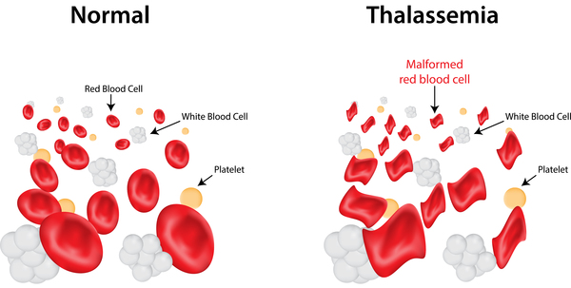
Thalassemia
Mutation of the gene responsible for red blood cell/haemoglobin production
Defects in the formation of haemoglobin/abnormal shape haemoglobin
Sufferers have fewer functioning red blood cells
Sufferers can have anaemia/iron deficiency/bone malformations/heart defects/enlarged spleen/slow growth rates
Recessive trait/passed from affected parents/passed from two carrier parents
Affects populations around Mediterranean Sea/Greek/Italian
More mutations in red blood cell formation increases the severity of the disease/can inherit multiple mutations
Individuals affected with mild thalassemia only have 1–2 mutations/Individuals affected with severe thalassemia have 3–4 mutations
More mutations found in gene pool greatly increases mortality rate
Resistance to malaria/increases thalassemia allele frequency in population

Slide 7
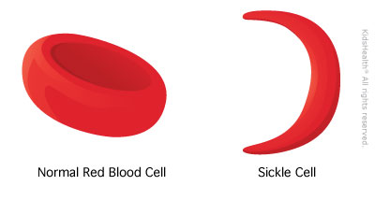
Sickle Cell Anaemia
Mutation of the gene responsible for red blood cell/haemoglobin production
Red blood cells that have a sickle shape
Reduces oxygen carrying ability of red blood cells
Fatigue/shortness of breath/anaemia/pain/swelling and inflammation of hands or feet/bacterial infections/sudden pooling of blood in spleen/liver congestion/lung and heart injury/leg ulcers
Recessive trait/passed from affected parents/passed from two carrier parents
Affects Black African populations/India/SE Asia/Italy
Individuals homozygous for condition usually die early/disease can be fatal
Individuals heterozygous for the condition are called ‘sicklers’/have sickle–trait
Heterozygous individuals are resistant to malaria/increases sickle cell allele frequency in population

